Slide 1


Netflix Catalog Analysis: Uncovering Content Strategy
Analyzing 499 movies to inform content strategy, audience targeting, and recommendation systems.

Slide 2





Project Overview & Goals
Explore Catalog Patterns
Identify Dominant Content
Uncover trends in genre distribution, box office performance, and viewer ratings.
Pinpoint dominant genres and high-performing titles for strategic focus.
Inform Future Strategy
Use insights to guide content acquisition, audience targeting, and recommendation systems.

Slide 3
Dataset Summary: 499 Movies
Key Features (9 Columns)
Data Preparation in Python
Release Information: Release_Date (year)
Data Loading and Initial Exploration (pandas)
Movie Metadata: Title, Genre, Language
Checked for Missing/Duplicate Data (None found)
Performance Metrics: Popularity, Vote_Count, Vote_Average, Box_Office
Feature Engineering for analysis

Slide 4




Feature Engineering: Preparing Data for Insights
Extract Year
Categorize Metrics
Isolate year from Release_Date column.
Group Vote_Average into (Super Hit, Hit, Average, Flop).
Explode Genre Data
Optimize Memory
Split Genre into a list; one genre per row for detailed analysis.
Cast 'Genre' column to category for better memory utilization.

Slide 5
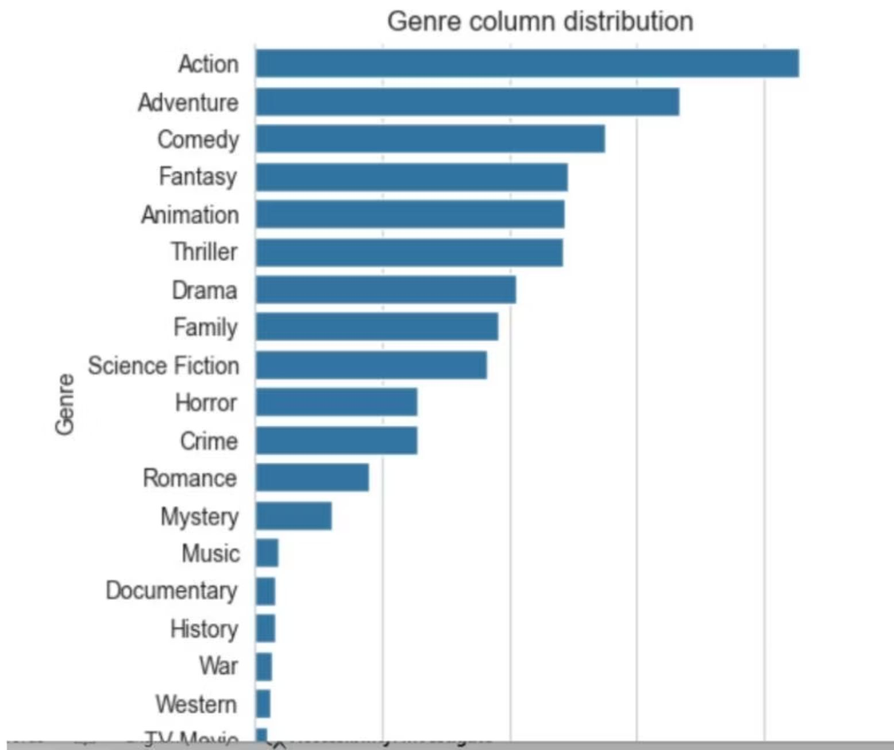
Dominant Genre: Action Leads the Catalog
Most Frequent Genre
Action
Action is the most frequent genre in the dataset, with a count of 243.
Followed by Adventure, Comedy, Fantasy, and Animation.

Slide 6
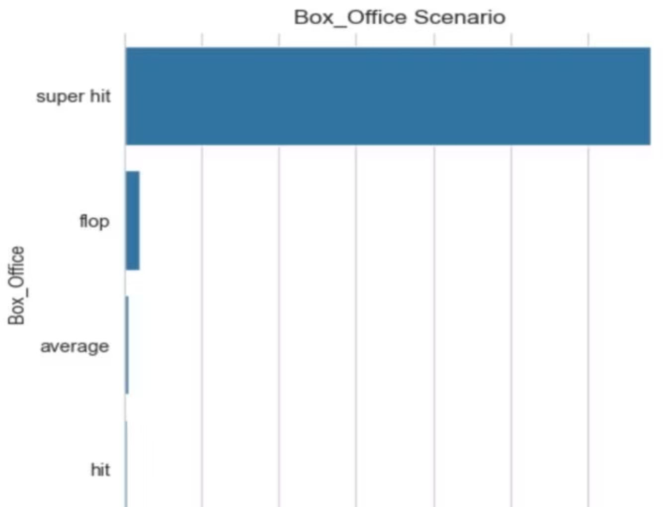
Box Office Scenario: Overwhelming Success
The overall Box Office analysis reveals a highly successful catalog.
96%
Super Hit Movies
Vast majority of total movies fall into the 'Superhit' category.
3%
Flop Movies
The 'Flop' category is significantly smaller.

Slide 7
Popularity Extremes: High vs. Low
Highest Popularity Rate
Spider-Man: No Way Home
Popularity: 5083.954 | Genres: Action, Adventure, Science Fiction
Lowest Popularity Rate
Furious 7
Popularity: 105.485 | Genres: Action, Thriller, Crime, Adventure
These titles represent the range of audience appeal within the catalog.

Slide 8
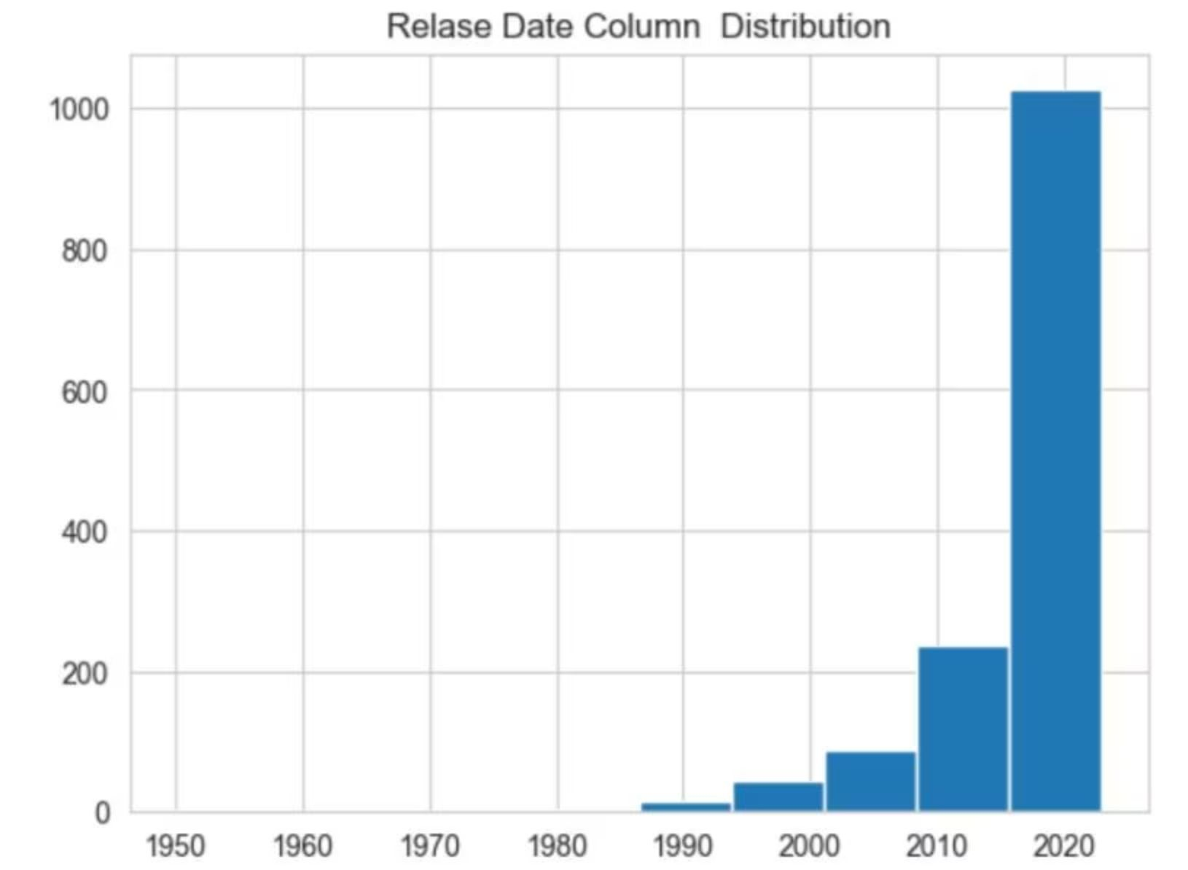
Release Year Trends: Peak in 2021
Highest Release Count
2021
The year 2021 stands out as the peak release year in the dataset, with 537 movies added.
Chart shows a significant increase in releases starting around 2000.

Slide 9

Business Recommendations: Content Strategy
Focus on Action
1
Continue investing in Action-oriented titles, as it is the most frequent and popular genre.
Leverage Superhits
2
Highlight 95%+ Superhit titles in marketing and recommendation algorithms to build trust.
Prioritize Blockbusters
3
Promote high-performing franchises like Spider-Man for strong audience appeal.

Slide 10


Strategic Adjustments & Future Focus
Analyze Low Performers
Capitalize on Peak Years
Investigate why titles like Furious 7 underperform despite strong genres. Reposition or limit promotion.
Investigate the surge in 2021 releases (537 movies) and replicate successful production strategies.

